Slide 1
CHAPTER 4 - DEMAND FORECASTING & COLLABORATIVE PLANNING, FORECASTING, & REPLENISHMENT
Principles of Supply Chain Management:
A Balanced Approach

Slide 2
Learning Objectives
You should be able to:
  Explain the role of demand forecasting in a supply chain.
  Identify the components of a forecast
  Compare and contrast qualitative and quantitative forecasting techniques
  Assess the accuracy of forecasts
  Explain collaborative planning, forecasting, and replenishment

Slide 3
Chapter Five Outline
Introduction
Matching Supply and Demand
Forecasting Techniques
  Qualitative Methods
  Quantitative Methods
Forecast Accuracy
Collaborative Planning, Forecasting, and Replenishment
Software Solutions

Slide 4

Introduction
Forecasting provides an estimate of future demand
The goal is to minimize forecast error.
Factors that influence demand and whether these factors will continue to influence demand must be considered when forecasting.
Improved forecasts benefit all trading partners in the supply chain.
Better forecasts result in lower inventories, reduced stock-outs, smoother production plans, reduced costs, and improved customer service.

Slide 5
Matching Supply and Demand
Suppliers must accurately forecast demand so they can produce & deliver the right quantities at the right time at the right cost.
Suppliers must find ways to better match supply and demand to achieve optimal levels of cost, quality, and customer service to enable them to compete with other supply chains.
Problems that affect product & delivery will have ramifications throughout the chain.

Slide 6
Forecasting Techniques
Qualitative forecasting is based on opinion and intuition.
Quantitative forecasting uses mathematical models and historical data to make forecasts.
Time series models are the most frequently used among all the forecasting models.

Slide 7
Forecasting Techniques- Cont.
Qualitative Forecasting Methods
Generally used when data are limited, unavailable, or not currently relevant. Forecast depends on skill & experience of forecaster(s) & available information.
Four qualitative models used are:
  Jury of executive opinion
  Delphi method
  Sales force composite
  Consumer survey

Slide 8
Forecasting Techniques- Cont.
Quantitative Methods
Time series forecasting- based on the assumption that the future is an extension of the past. Historical data is used to predict future demand.
Associative forecasting- assumes that one or more factors (independent variables) predict future demand.
It is generally recommended to use a combination of quantitative and qualitative techniques.

Slide 9
Forecasting Techniques- Cont.
Components of Time Series- Data should be plotted to detect for the following components:
  Trend variations: either increasing or decreasing
  Cyclical variations: wavelike movements that are longer than a year
  Seasonal variations: show peaks and valleys that repeat over a consistent interval such as hours, days, weeks, months, years, or seasons
  Random variations: due to unexpected or unpredictable events

Slide 10
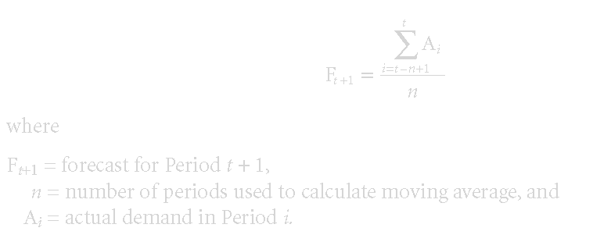
Forecasting Techniques- Cont.
Time Series Forecasting Models
  Simple Moving Average Forecasting Model. Simple moving average forecasting method uses historical data to generate a forecast. Works well when demand is fairly stable over time.

Slide 11
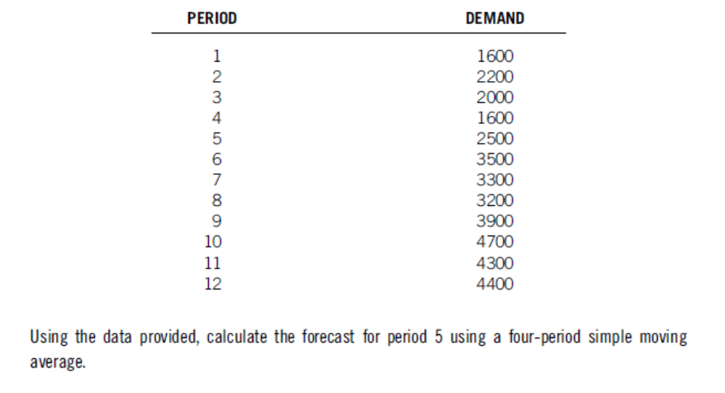
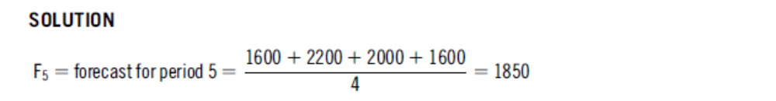
SMA-Example

Slide 12
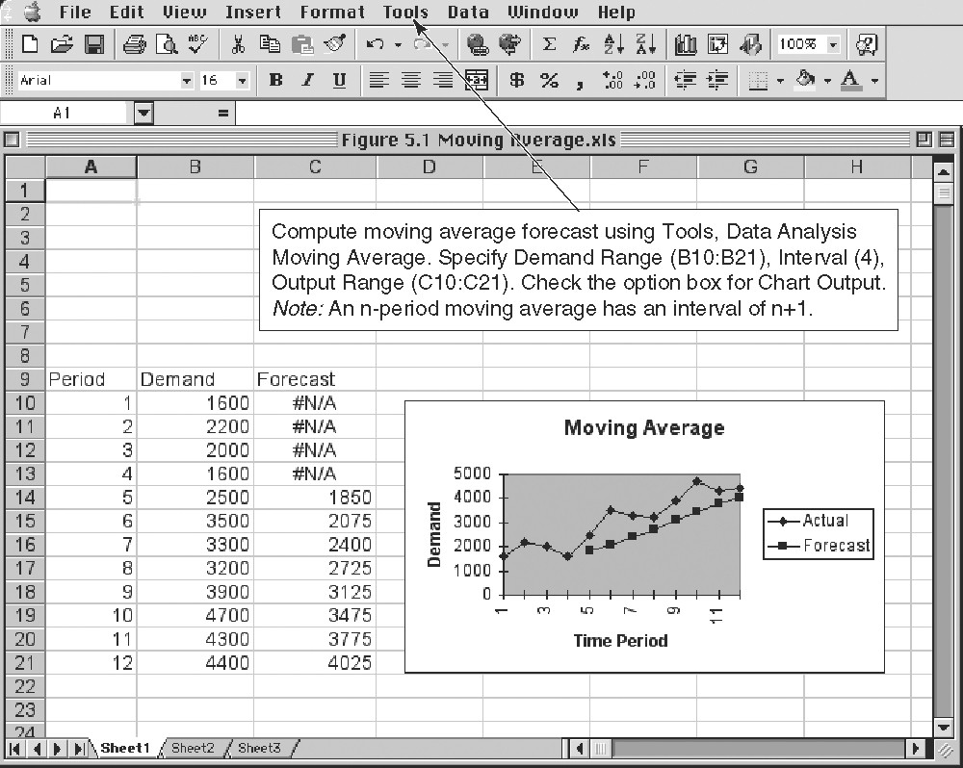
Forecasting Techniques- Cont.

Slide 13
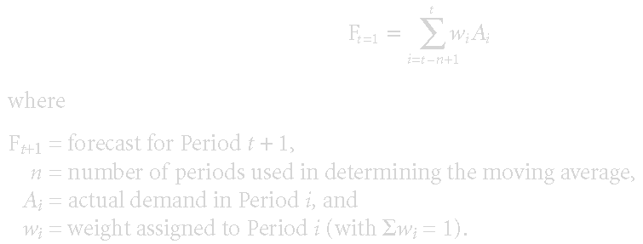
Forecasting Techniques- Cont.
Time Series Forecasting Models
  Weighted Moving Average Forecasting Model- based on an n-period weighted moving average, follows:

Slide 14
WMA-Example
Calculate the forecast for period 5 using a four-period weighted moving average for the same data (previous example). The weights of 0.4, 0.3, 0.2 and 0.1 are assigned to the most recent, second most recent, third most recent and fourth most recent periods respectively,

Slide 15
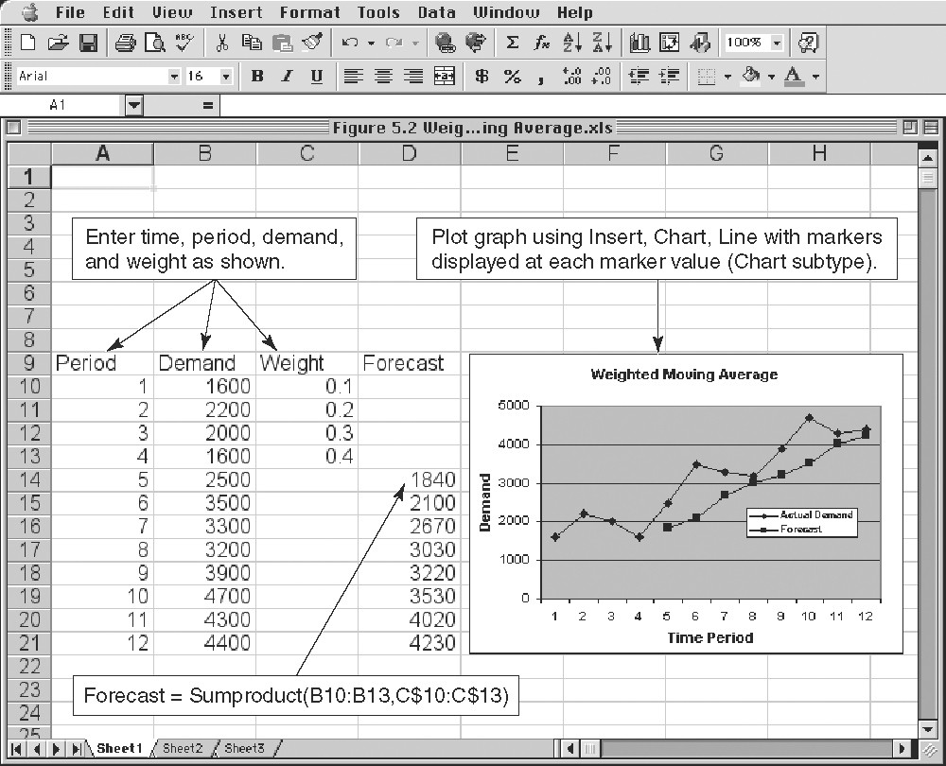
Forecasting Techniques- Cont.

Slide 16
Forecasting Techniques- Cont.
Time Series Forecasting Models
  Exponential Smoothing Forecasting Model- a weighted moving average in which the forecast for the next period’s demand is the current period’s forecast adjusted by a fraction of the difference between the current period’s actual demand and its forecast. Only two data points are needed.
    Ft+1 = Ft+α(At-Ft) or Ft+1 = αAt + (1 – α) Ft
    Where
    Ft+1 = forecast for Period t + 1
    Ft = forecast for Period t
    At = actual demand for Period t
    α = a smoothing constant (0 ≤ α ≤1).

Slide 17
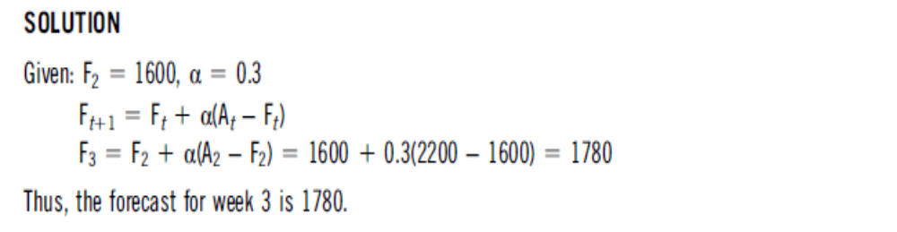
Exponential Smoothing-Example
Based on the data for previous example, calculate the forecast for period 3 using exponential smoothing method. Assume that the forecast for period 2 is 1600 and use a smoothing constant (α) of 0.3.

Slide 18
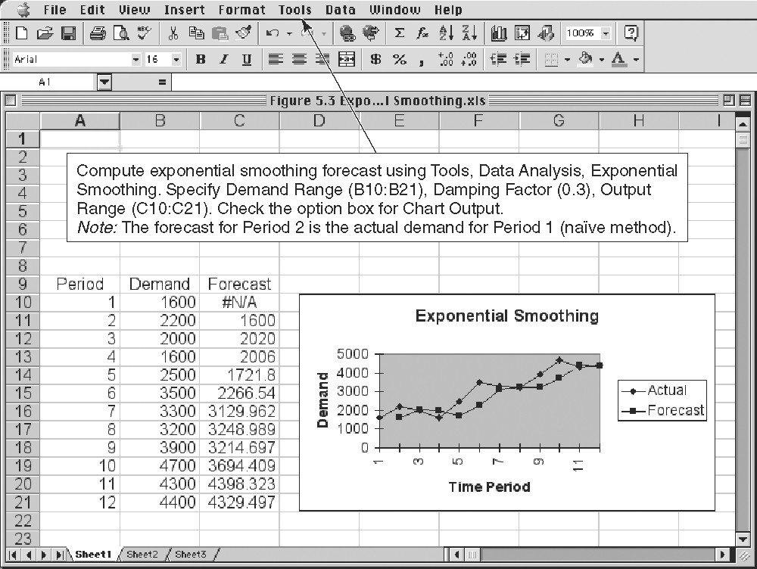
Forecasting Techniques- Cont.

Slide 19
Forecasting Techniques- Cont.
Time Series Forecasting Models
  Trend-Adjusted Exponential Smoothing forecasting Model. a trend component in the time series shows a systematic upward or downward trend in the data over time.
      Ft = αAt + (1 - α)(F t+1 + Tt-1),
      Tt = ß(Ft-Ft-1) + (1 – ß)Tt-1,
  and the trend-adjusted forecast,
      TAFt+m = Ft+ mTt
  where
    Ft = exponentially smoothed average in Period t
    At = actual demand in Period t
    Tt = exponentially smoothed trend in Period t
    α = smoothing constant (0 ≤ α ≤ 1)
    ß = smoothing constant for trend (0 ≤ ß ≤ 1)

Slide 20
Forecasting Techniques- Cont.
Time Series Forecasting Models
  Linear Trend Forecasting Model. The trend can be estimated using simple linear regression to fit a line to a time series.
    Ŷ = b₀ + b₁x
      where
        Ŷ = forecast or dependent variable
        x = time variable
        B₀ = intercept of the line
        b₁ = slope of the line

Slide 21
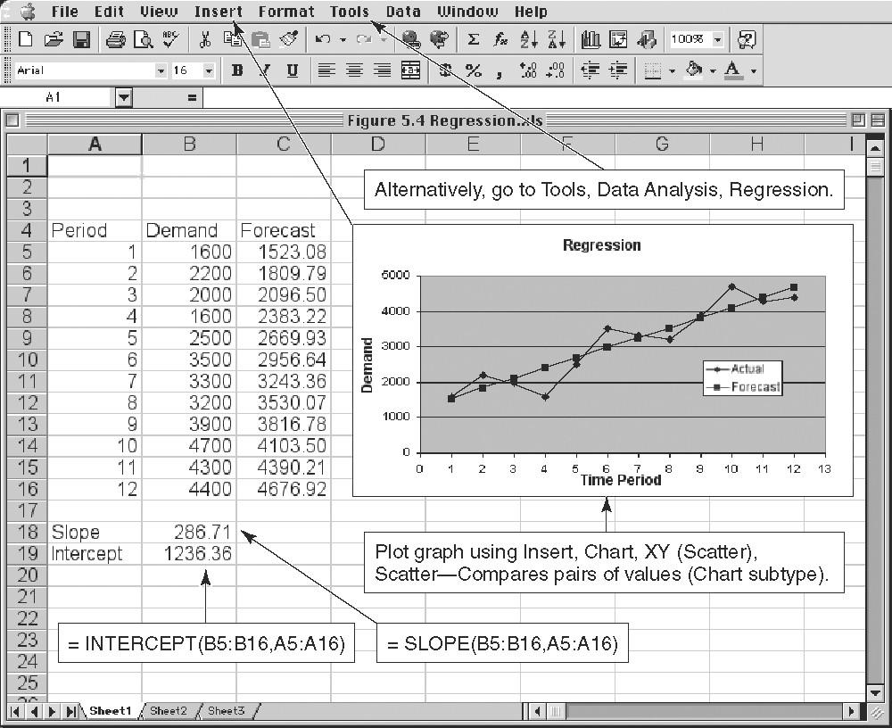
Forecasting Techniques- Cont.

Slide 22
Forecasting Techniques- Cont.
Associative Forecasting Models- One or several external variables are identified that are related to demand
  Simple regression. Only one explanatory variable is used and is similar to the previous trend model. The difference is that the x variable is no longer a time but an explanatory variable.
    Ŷ = b₀ + b₁x
      where
        Ŷ = forecast or dependent variable
        x = explanatory or independent variable
        b₀ = intercept of the line
        b₁ = slope of the line

Slide 23
Least Squares Method
Equations to calculate the regression variables
^
y = a + bx
Σxy - nxy
Σx² - nx²
b =
a = y - bx

Slide 24
LSM-Example
Time Electrical Power
Year Period (x) Demand x² xy
2001 1 74 1 74
2002 2 79 4 158
2003 3 80 9 240
2004 4 90 16 360
2005 5 105 25 525
2005 6 142 36 852
2007 7 122 49 854
∑x = 28 ∑y = 692 ∑x² = 140 ∑xy = 3,063
x = 4 y = 98.86
∑xy - nxy
∑x² - nx²
3,063 - (7)(4)(98.86)
140 - (7)(4²)
b = = = 10.54
a = y - bx = 98.86 - 10.54(4) = 56.70

Slide 25
Example-Cont.
The trend line is
^
y = 56.70 + 10.54x

Slide 26
Example-Cont.
Trend line,
y = 56.70 + 10.54x
160 –
150 –
140 –
130 –
120 –
110 –
100 –
90 –
80 –
70 –
60 –
50 –
^
Power demand
| | | | | | | | |
2001 2002 2003 2004 2005 2006 2007 2008 2009
Year

Slide 27
Forecasting Techniques- Cont.
Associative Forecasting Models-
  Multiple regression. Where several explanatory variables are used to make the forecast.
    Ŷ = b₀ + b₁x₁ + b₂x₂ + . . . b_{k}x_{k}
      where
        Ŷ = forecast or dependent variable
        x_{k} = kth explanatory or independent variable
        b₀ = intercept of the line
        b_{k} = regression coefficient of the independent variable x_{k}

Slide 28
Least Squares Requirements
We always plot the data to insure a linear relationship
We do not predict time periods far beyond the database
Deviations around the least squares line are assumed to be random

Slide 29
Correlation
How strong is the linear relationship between the variables?
Correlation does not necessarily imply causality!
Coefficient of correlation, r, measures degree of association
  Values range from -1 to +1

Slide 30
y
y
(a) Perfect positive correlation:
r = +1
x
x
(b) Positive correlation:
0 < r < 1
y
y
x
x
(c) No correlation:
r = 0
(d) Perfect negative correlation:
r = -1

Slide 31
Correlation Coefficient
nΣxy - ΣxΣy
[nΣx² - (Σx)²][nΣy² - (Σy)²]
r =

Slide 32
Coefficient of Determination
Coefficient of Determination, r², measures the percent of change in y predicted by the change in x
  Values range from 0 to 1
  Easy to interpret

Slide 33
Forecast Accuracy
The formula for forecast error, defined as the difference between actual quantity and the forecast, follows:
    Forecast error, e_{t} = A_{t} - F_{t}
    where
    e_{t} = forecast error for Period t
    A_{t} = actual demand for Period t
    F_{t} = forecast for Period t
Several measures of forecasting accuracy follow:
  Mean absolute deviation (MAD)- a MAD of 0 indicates the forecast exactly predicted demand.
  Mean absolute percentage error (MAPE)- provides perspective of the true magnitude of the forecast error.
  Mean squared error (MSE)- analogous to variance, large forecast errors are heavily penalized
  Running sum of forecast error (RSFE)- sum off all errors for period t.

Slide 34
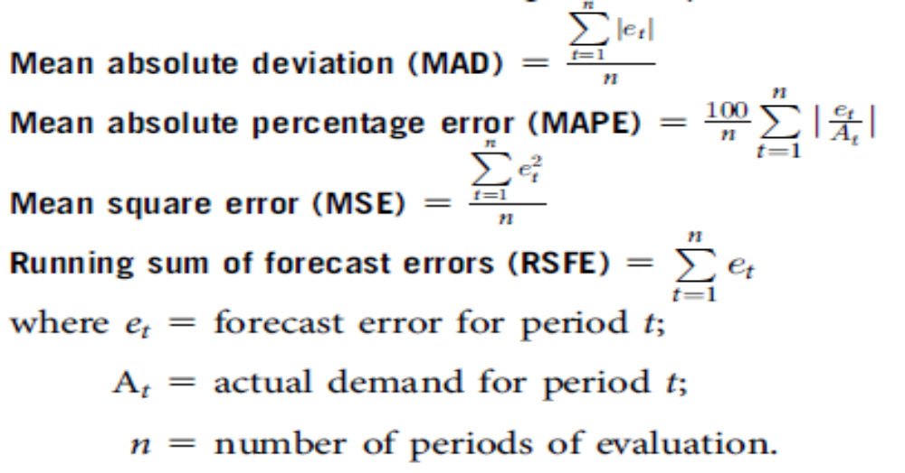
Formulae

Slide 35
Monitoring and Controlling Forecasts
Tracking Signal
Measures how well the forecast is predicting actual values
Ratio of running sum of forecast errors (RSFE) to mean absolute deviation (MAD)
  Good tracking signal has low values
  If forecasts are continually high or low, the forecast has a bias error

Slide 36
Tracking Signal
Signal exceeding limit
+
0 MADs
–
Tracking signal
Upper control limit
Acceptable range
Lower control limit
Time

Slide 37
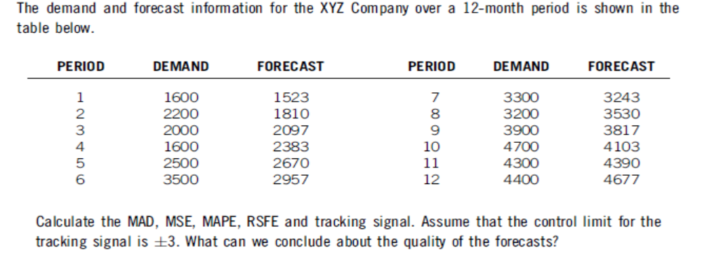
Example

Slide 38
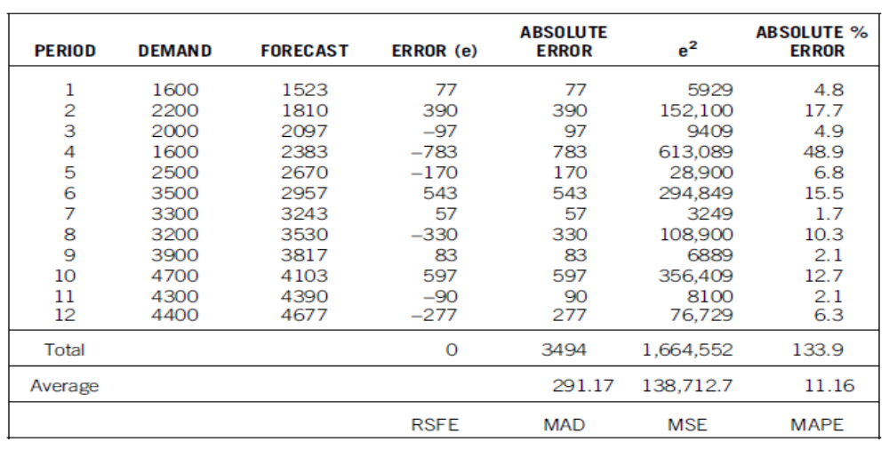
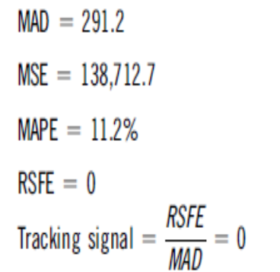
Example-Cont.
The results indicate no bias and the tracking signal is well within the control limit. However, the forecast are on average 291 units or 11.2% off from the actual demand. The situation might require attention to determine the underlaying cause of variation.

Slide 39
Collaborative Planning, Forecasting, and Replenishment
Collaborative Planning, Forecasting, & Replenishment
“Collaboration process whereby supply chain trading partners can jointly plan key supply chain activities from production and delivery of raw materials to production and delivery of final products to end customers”
American Production and Inventory Control Society (APICS).
Objective of CPFR- optimize supply chain through improved demand forecasts, with the right product delivered at right time to the right location, with reduced inventories, avoidance of stock-outs, & improved customer service.
Value of CPFR- broad and open exchange of forecasting information to improve forecasting accuracy when both the buyer and seller collaborate through joint knowledge of base sales, promotions, store openings or closings, & new product introductions.
Principles of Supply Chain Management: A Balanced Approach by Wisner, Leong, and Tan.
© 2005 Thomson Business and Professional Publishing

Slide 40
Collaborative Planning, Forecasting, and Replenishment
Most firms implement CPFR based on Voluntary Interindustry Commerce Standards Process Model
  Step 1: Develop Collaboration Arrangement
  Step 2: Create Joint Business Plan
  Step 3: Create Sales Forecast
  Step 4: Identify Exceptions for Sales Forecast
  Step 5: Resolve/Collaborate on Exception Items
  Step 6: Create Order Forecast
  Step 7: Identify Exceptions for Order Forecast
  Step 8: Resolve/Collaborate on Exception Items
  Step 9: Order Generation
Principles of Supply Chain Management: A Balanced Approach by Wisner, Leong, and Tan.
© 2005 Thomson Business and Professional Publishing

Slide 41
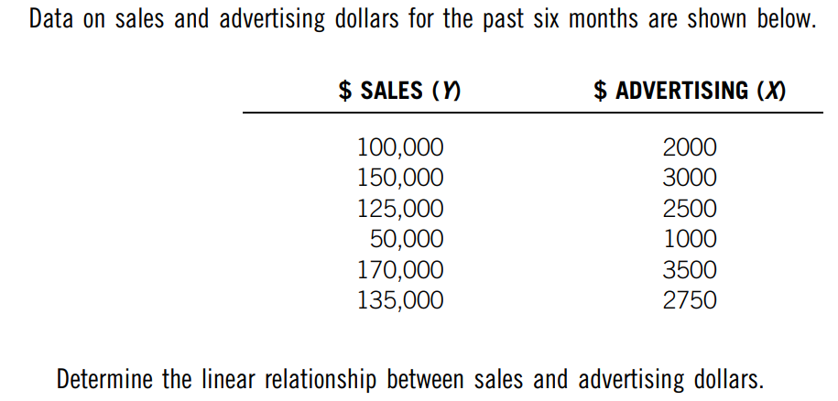
Practice Question 1

Slide 42
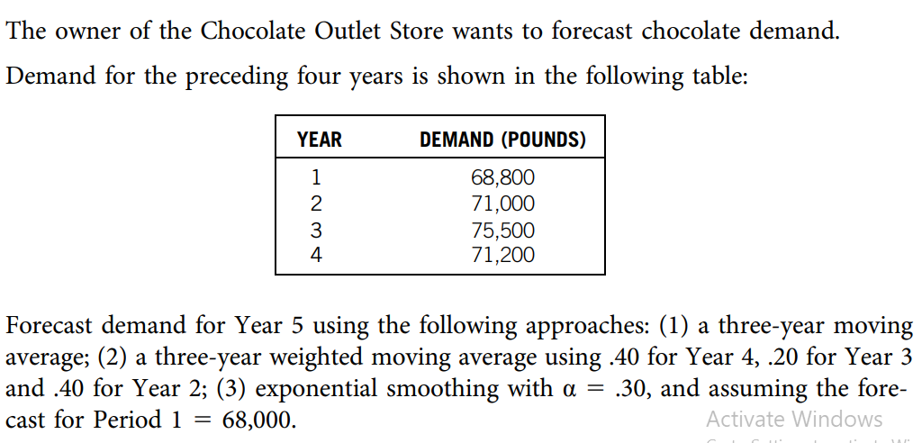
Practice Question 2

Slide 43
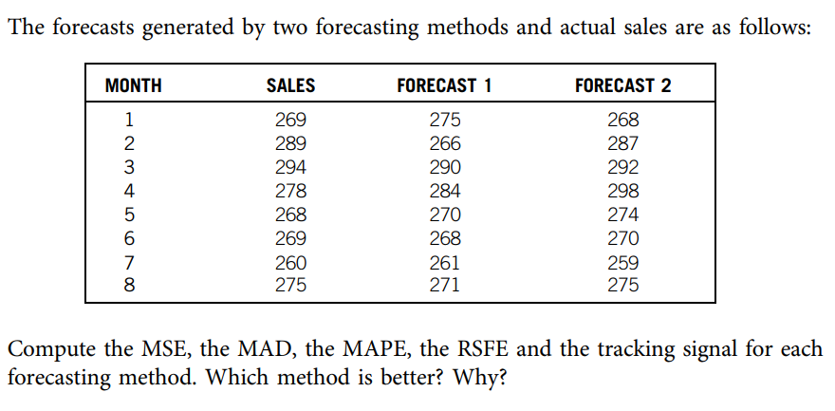
Practice Question 3

